Slide 1




SANJAY GHODAWAT UNIVERSITY
Kolhapur
Established under section 2(f) of UGC Act 1956
Sanjay Ghodawat University Act XL of 2017 of Govt. Maharashtra Approved by PCI, COA & AICTE
PROJECT SYNOPSIS PRESENTATION
On
“Student Information Management System”
By
SANKALP S. MISAL TEJAS S. DHOLE MANGESH S.PATIL PRAJWAL C.KAMATE
22SC114281057
22SC114281058
22SC114281066
22SC114281047
Under supervision
of
Mr. Sanket Prabhu
Program : B. Tech
Class : FY CSE (Division A)
School of Computer Science and Engineering A.Y 2022-23

Slide 2
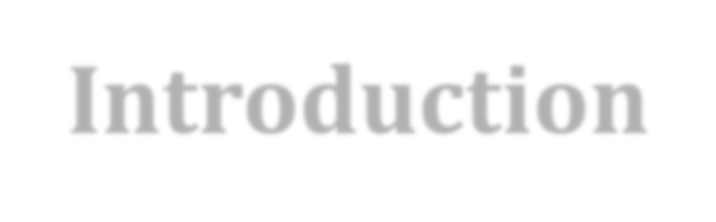
Introduction
This project “Student Information Management System” provides us a simple interface for maintanance of student information. It can be used by educational institutes or colleges to maintain the records of students easily. Achieving this objective is difficult using a manual system as the information is scattered, can be redundant and collecting relevant information may be very time consuming. All these problems are solved using this project.
Throughout the project the focus has been on presenting information in an easy and intelligible manner. The project is very useful for those who want to know about Student Information Management Systems and want to develop softwares/websites based on the same concept.
The project provides facilities like online registration and profile creation of students thus reducing paperwork and automating the record generation process in an educational institution.

Slide 3
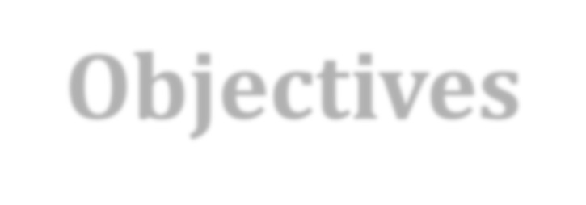
Objectives
Faculties can access the information of all the students easily.
A student management system is also a
student database management system.
It helps you all the student related data in a
well organized manner.
A student management system gives you a unique ID against every student and using that ID you can easily track the fees status, assignment, exam result, grades, parent information within seconds.

Slide 4
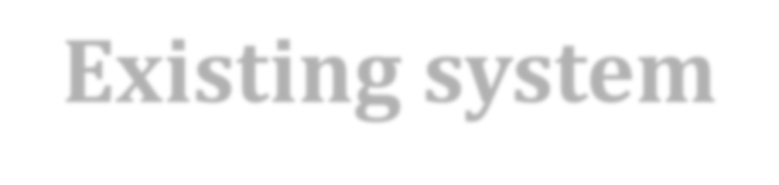
Existing system
EXISTING SYSTEM: System Analysis is a detailed study of the various operations performed by a system and their relationships within and outside of the system. Here the key question is- what all problems exist in the present system? What must be done to solve the problem? Analysis begins when a user or manager begins a study of the program using existing system. During analysis, data collected on the various files, decision points and transactions handled by the present system. The commonly used tools in the system are Data Flow Diagram, interviews, etc. Training, experience and common sense are required for collection of relevant information needed to develop the system. A good analysis model should provide not only the mechanisms of problem understanding but also the frame work of the solution. Thus, it should be studied thoroughly by collecting data about the system. Then the proposed system should be analyzed thoroughly in accordance with the needs. System analysis can be categorized into four parts. System planning and initial investigation Information Gathering Applying analysis tools for structured analysis Feasibility study Cost/ Benefit analysis. In the current system we need to keep a number of records related to the student and want to enter the details of the student and the marks manually. In this system only, the teacher or the school authority views the mark of the student and they want to enter the details of the student. This is time consuming and has much cost.

Slide 5
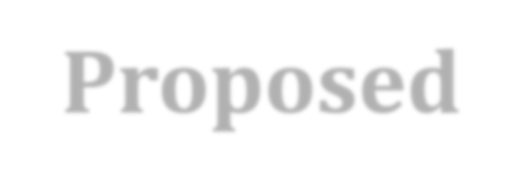
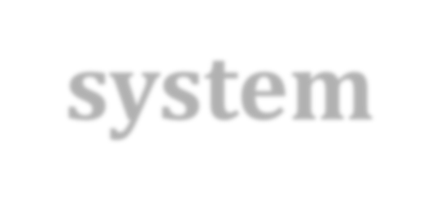
Proposed system
In our proposed system we have the provision for adding the details of the students by themselves. So, the overhead of the school authorities and the teachers is become less. Another advantage of the system is that it is very easy to edit the details of the student and delete a student when it found unnecessary. The marks of the student are added in the database and so students can also view the marks whenever they want. Our proposed system has several advantages:-
User friendly interface
Fast access to database
Less error
More Storage Capacity
Search facility
Look and Feel Environment
Quick transaction All the manual difficulties in managing.

Slide 6
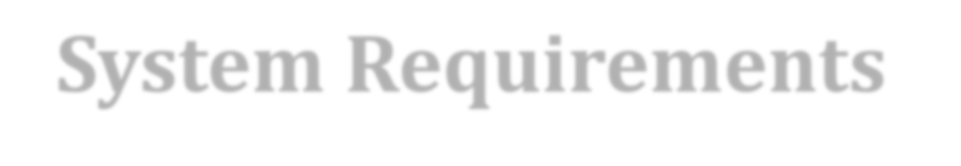

System Requirements Specification
SOFTWARE REQUIREMENTS
Turbo C++ / Dev C++.
HARDWARE REQUIREMENTS
4 GB RAM
500 GB HDD
I3 processor

Slide 7

Flowchart
Start
Enter Student PRN NO.
NAME
ROLL NO.
BRANCH
DOD
ADDRESS
MARKS
EXIT

Slide 8
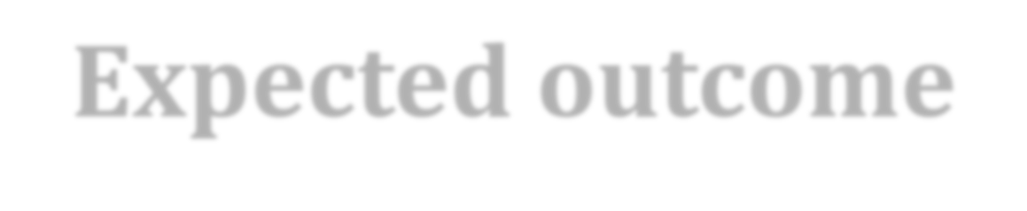
Expected outcome
Outputs from computer systems are required primarily to communicate the results of processing to users. They are also used to provide a permanent copy of these result for latter consultation. Computer output is the most important and direct source of information to the users.
Designing computer output should proceed in an organized well through out the manner. The right output must be available for the people who find the system easy o use. The outputs have been defined during the logical design stage. If not, they should have defined at the beginning of the output designing terms of types of output connect, format, response etc.

Slide 9

References
To make this program we were see some videos of youtubers such as Aniket The Programmer (https://www.youtube.com/@AniketTheProgrammer) and also Apna School(https://www.youtube.com/@ApnaCollegeOfficial).
We are google the same information and get help of some websites like Source code project(https://codeprojects.org/) and Include help(https://www.includehelp.com/cprograms/perform-the-atm- transactions.aspx). And also took some help of our teacher Sanket Prabhu sir.

Slide 10


